Slide 1
Lab stand control

Slide 2
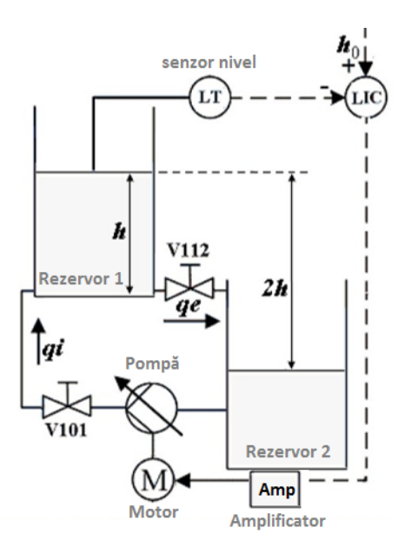
Process description
2 water tanks with the same transversal section, one on top of the other
the control is being performed on the first tank, which is on top
ultrasonic sensor
flow sensors
pump
amplifier for the control signal
manual valves and solenoid valves

Slide 3
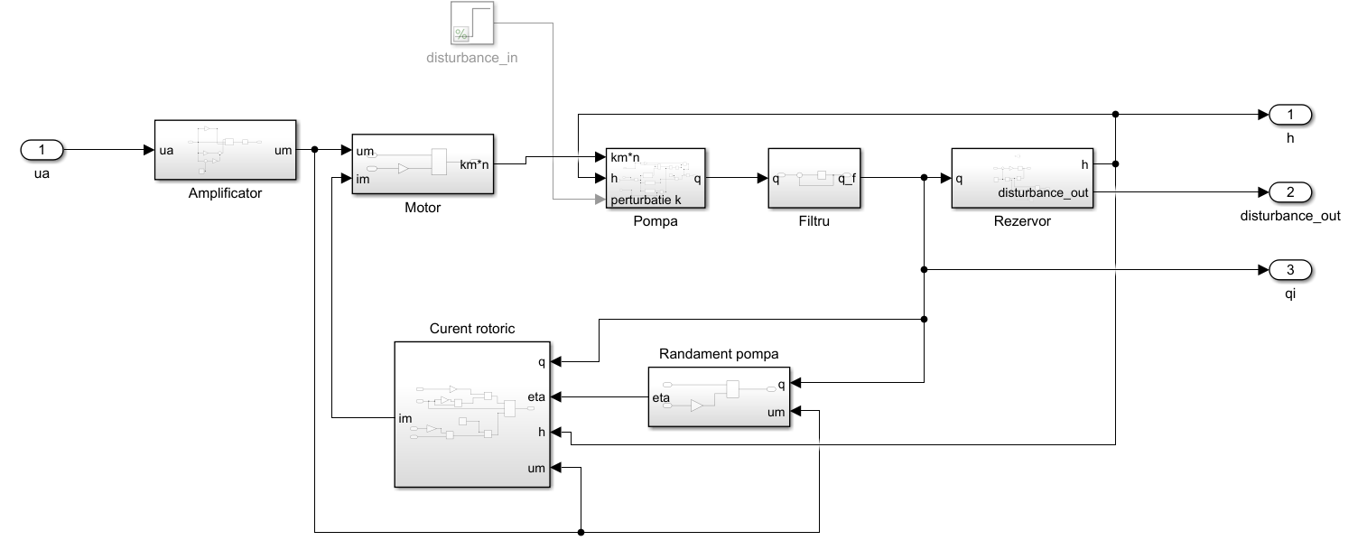
Process modeling

Slide 4
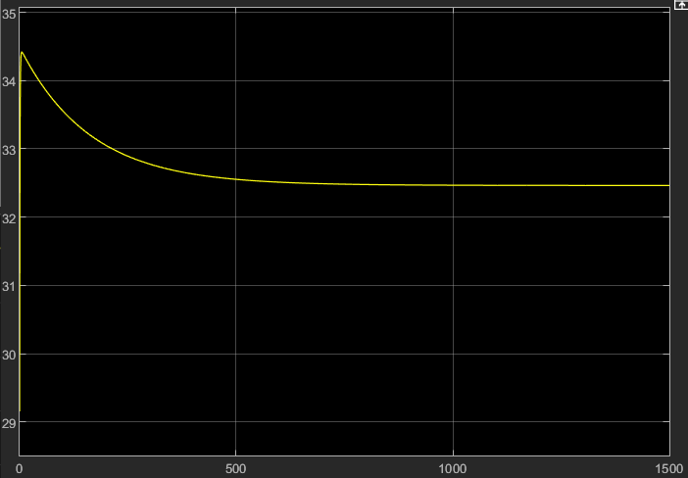
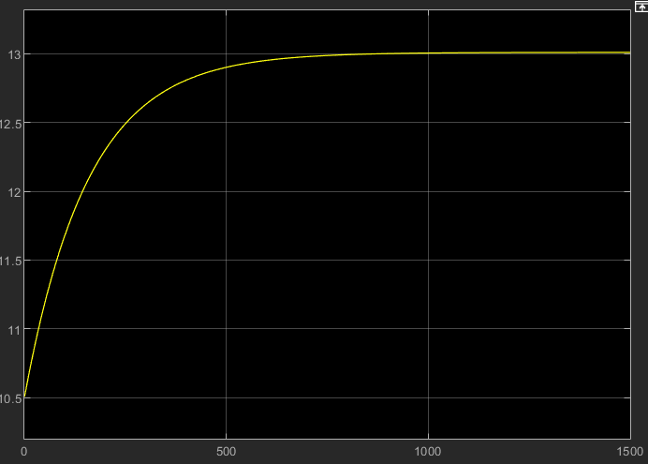
Open loop simulations
level
flow

Slide 5
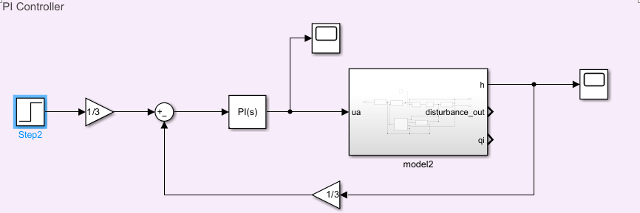
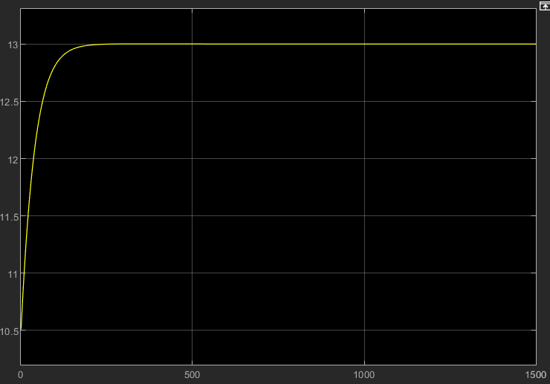
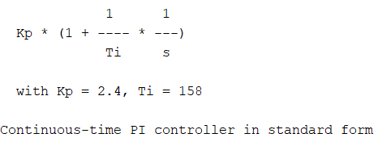
PI Controller
identify the linear model near the operating point ua=5
design the closed loop dynamics as a first order transfer function
calculate the controller

Slide 6
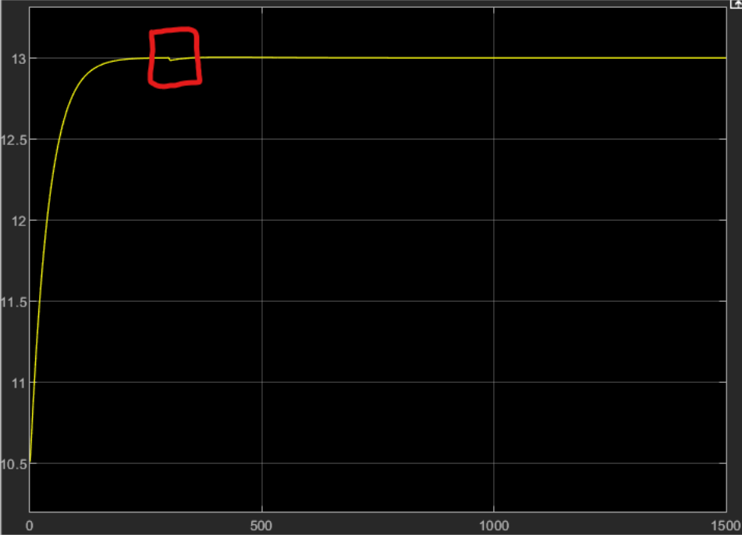
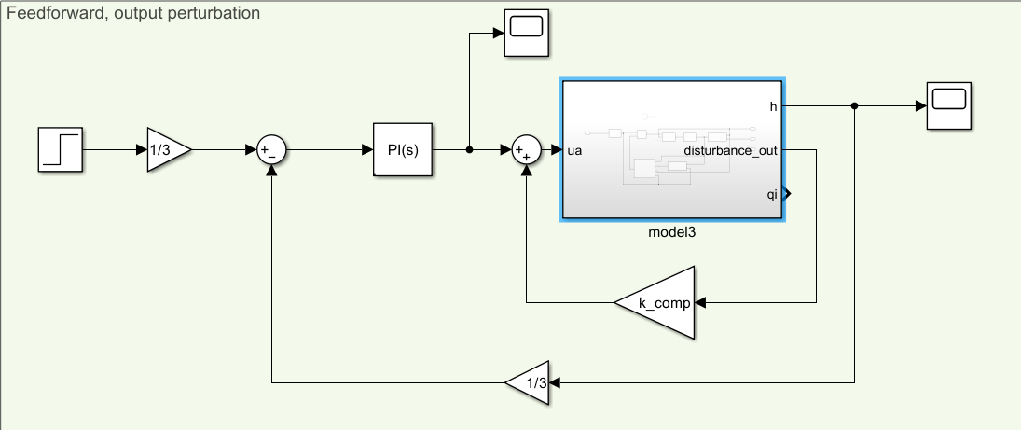
Feedforward control
design a static gain to counter the effect of the perturbation on the output flow

Slide 7
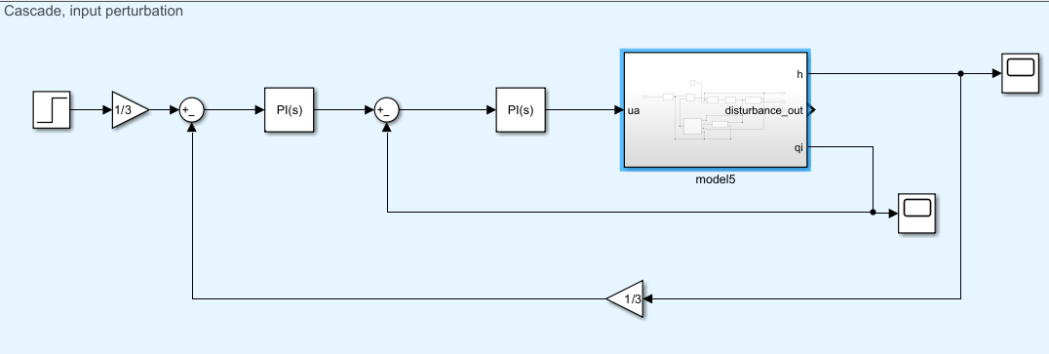
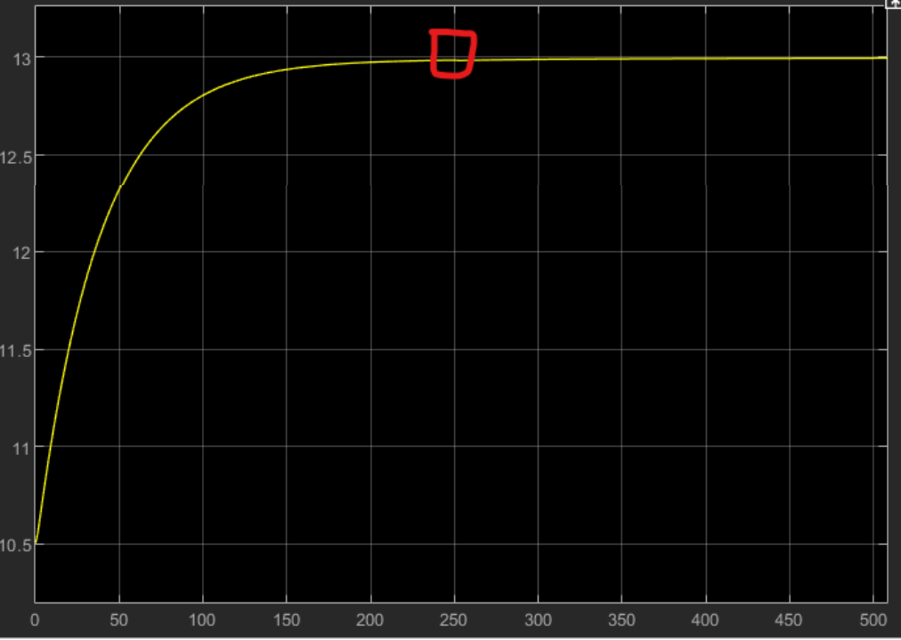
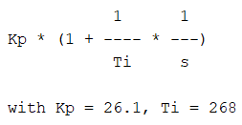
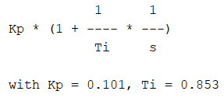
Cascade control
consider the series connection of the designed controller, the fast part and the slow part
treat the above system as a new process and design a new controller for it
break the system in 2 parts: the fast one and the slow one
design a controller for the fast one
the perturbation on the input flow is rejected

